Slide 1
Secure Electronic Transaction
By
G.Bhargavi
N170515

Slide 2
WHAT IS SET?
Secure Electronic Transaction is a communications protocol
Standard for securing credit card transactions over networks,specificially the Internet.
Set was used in february 1996 and was proposed by Visa and Master cards.

Slide 3
Key Features of SET
Confindentiality of Information.
A credit cardholder’s personal and payment information is secured as it travels across the network.An interesting feature of SET is that the merchant/seller never sees the credit card number.
Integrity of Data.
Payment information sent from Cardholders to merchants include order information ,personal information and payment instructions.
SET guarantees that these message contents are not altered during transaction
.

Slide 4
Contd….
Cardholder account Authentication
SET enables merchants to verify that a cardholder is legitimate user of a valid card account number.
Cardholder authentication programs are security processes that protect merchants by verifying a customer's identity
Merchant Authentication
SET enables Cardholders to verify that a merchant has a relationship with a financial Institution allowing it to accept payment cards.

Slide 5
SET participants
Card holder
Merchant
Issuer
Acquirer
Payment Gateway
Certificate Authority

Slide 6
Cardholder & Merchant
Cardholder:
A person who will buy the product and this is a authorized holder of a payment card (eg:Master Card and visa card) that has been issued by the issuer person who will buy the produts .
Merchant:
This is a person or organization who has things to sell to the cardholder.A merchant that accepts credit cards must have a relationship with an acquirer.

Slide 7
Issuer & Acquirer
Issuer:
This is a Financial institution such as a bank which issues the account to the card holder with the payment Card.
Acquirer:
This is a Financial institution related to the Merchant,which accepts the payments from any bank account.

Slide 8
Payment Gateway & Certificate Authority
Payment Gateway:
This is a function that can be undertaken by the Acquirer or some third party that processes merchant payment messages
Certificate Authority:
This is a trusted third party to all the cardholders,merchants and payment gateways.

Slide 9
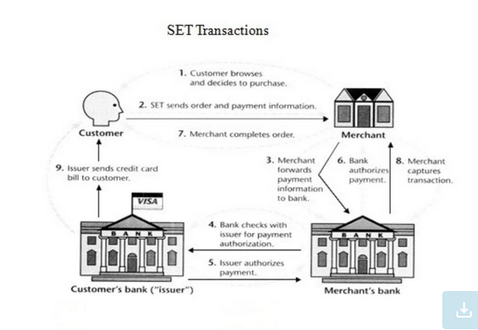

Slide 10
SET’s Dual Signature
Whatever we are passing the information while buying.
There are two messages intended for two different receivers:
1.Payment information(PI):Customer to Bank.
2.Order Information(OI):Customer to Merchant.
GOAL:
Merchant does not need credit card number.
Bank does not need details of customer order.

Slide 11
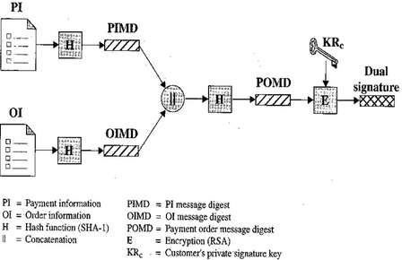
Dual Signature

Slide 12
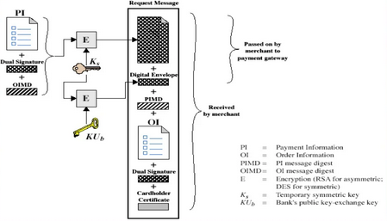
Purchase Request to customer

Slide 13
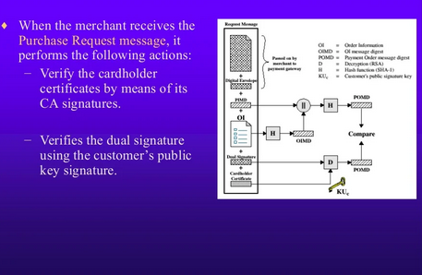
Merchant verifies Purchase Request

Slide 14
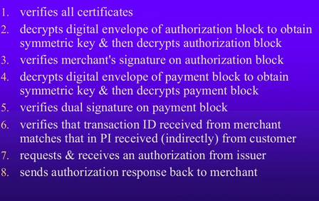
Payment Gateway Authorization

Slide 15
Payment Capture
After succesfull completion of above 2 steps, the merchant will send the valid transaction Id and request to the acquirer. So the acquirer will check it and the acquirer will debit from the card holder or customer and credit to the merchants account.

Slide 16
Thank you…

